Slide 1


Microprocessors and Assembly Language Spring 2020
Hamed Farbeh
farbeh@aut.ac.ir
Department of Computer Engineering
Amirkabir University of Technology
Lecture 15

Slide 2
Copyright Notice
Parts (text & figures) of this lecture are adopted from:
Arm Assembly Language Programming and Architecture, Volume 1, 1st edition, Muhammad Ali Mazidi, Sarmad Naimi, and Sepehr Naimi, MicroDigitalEd, 2013.
Microprocessors and Assembly Language, Spring 2020, AUT, Tehran, Iran

Slide 3
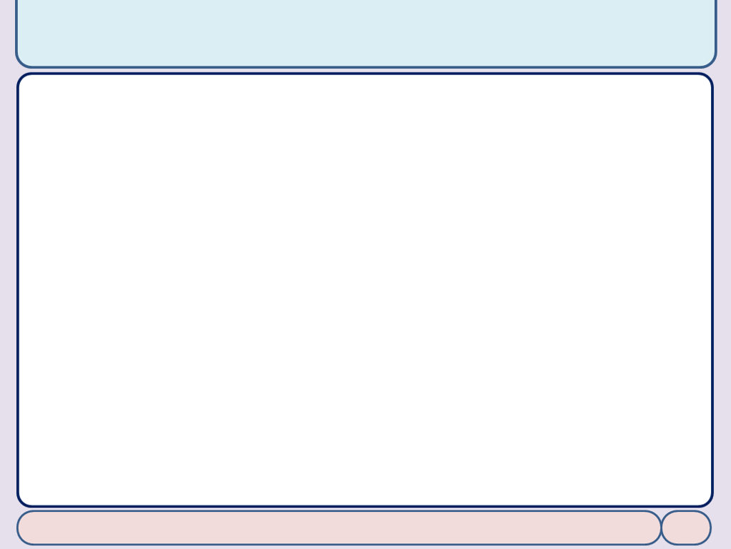
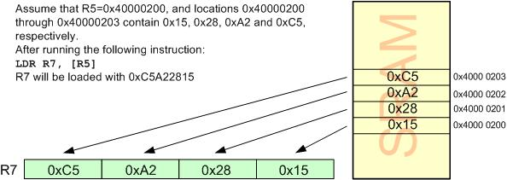
Load and Store Instructions
Load Rd with the contents of location pointed to by Rx register
LDR Rd,[Rx]; Rx contains an address between 0x00000000 to 0xFFFFFFFF
LDR reads one word (32-bit or 4-byte) of data
from 4 consecutive memory locations
The locations can be in the SRAM, a Flash memory or I/O registers
Microprocessors and Assembly Language, Spring 2020, AUT, Tehran, Iran

Slide 4
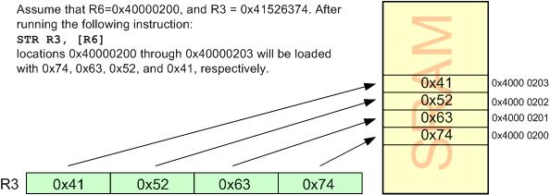
Load and Store Instructions
Store register Rd into locations pointed to by Rx
STR Rd,[Rx]
Microprocessors and Assembly Language, Spring 2020, AUT, Tehran, Iran

Slide 5
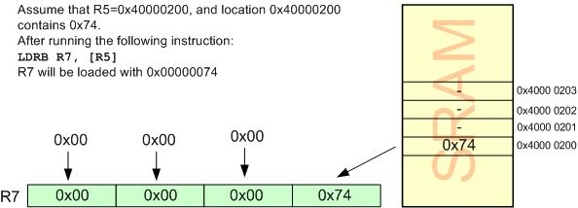
Load and Store Variations
Load a byte
LDRB Rd, [Rx]
Microprocessors and Assembly Language, Spring 2020, AUT, Tehran, Iran

Slide 6
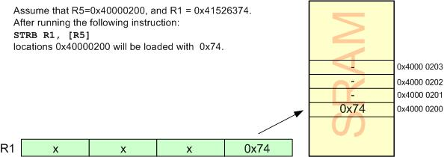
Load and Store Variations
Store a byte
STRB Rd, [Rx]
Microprocessors and Assembly Language, Spring 2020, AUT, Tehran, Iran

Slide 7
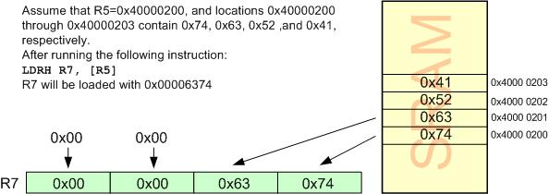
Load and Store Variations
Load half-word (2-byte)
LDRH Rd, [Rx]
Microprocessors and Assembly Language, Spring 2020, AUT, Tehran, Iran

Slide 8
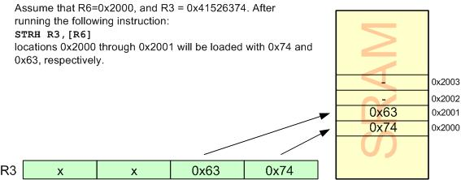
Load and Store Variations
Store half-word (2-byte)
STRH Rd, [Rx]
Microprocessors and Assembly Language, Spring 2020, AUT, Tehran, Iran

Slide 9
Current Program Status Register
CPSR: Flag register
N: Negative
Z: Zero
C: Carry
V: Overflow
T: Thumb
I and F: Enable or disable the interrupt
Microprocessors and Assembly Language, Spring 2020, AUT, Tehran, Iran

Slide 10
S suffix and the status register
By executing data processing instructions
By default, the status flags of CPSR are not updated
To update the flags
put the ‘S’ suffix at the end of the opcode
ADD => ADDS
Microprocessors and Assembly Language, Spring 2020, AUT, Tehran, Iran

Slide 11
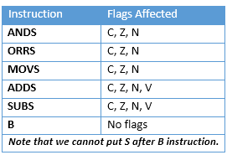
S Suffix and the Status Register
Microprocessors and Assembly Language, Spring 2020, AUT, Tehran, Iran

Slide 12
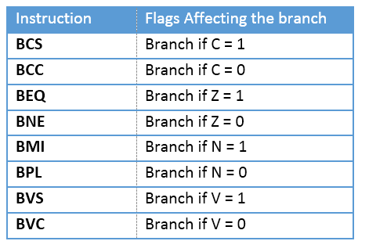
Flag Bits and Decision Making
Conditional branch instructions
Microprocessors and Assembly Language, Spring 2020, AUT, Tehran, Iran

